Slide 1
Help prevent the spread of infection!
The Centers for Disease Control and Prevention (CDC) recommends everyday preventive actions to help prevent the spread of respiratory diseases, including:
Avoid close contact with people who are sick.
Avoid touching your eyes, nose, and mouth.
Stay home when you are sick.
Cover your cough or sneeze with a tissue, then throw the tissue in the trash.
Clean and disinfect frequently touched objects and surfaces using a regular household cleaning spray or wipe.
Wash your hands often with soap and water for at least 20 seconds, especially after going to the bathroom; before eating; and after blowing your nose, coughing, or sneezing.
  If soap and water are not readily available, use an alcohol-based hand sanitizer with at least 60% alcohol. Always wash hands with soap and water if hands are visibly dirty.
The CDC does not recommend that people who are well wear a facemask to protect themselves from respiratory diseases.
Visit cdc.gov for more information.
People who think they may have been exposed to infection should contact their healthcare provider immediately.

Slide 2
Stay healthy with handwashing!
When to wash your hands
Handwashing is one of the best ways to protect yourself and your family from getting sick. The Centers for Disease Control and Prevention (CDC) recommends washing your hands:
Before, during, and after preparing food
Before eating food
Before and after caring for someone at home who is sick with vomiting or diarrhea
Before and after treating a cut or wound
After using the toilet
After changing diapers or cleaning up a child who has used the toilet
After blowing your nose, coughing, or sneezing
After touching an animal, animal feed, or animal waste
After handling pet food or pet treats
After touching garbage
Visit cdc.gov/handwashing for more information.

Slide 3
Stay healthy with handwashing!
Wash your hands the right way
Washing your hands is easy, and it’s one of the most effective ways to prevent the spread of germs. Clean hands can stop germs from spreading from one person to another and throughout an entire community—from your home and workplace to childcare facilities and hospitals. The Centers for Disease Control and Prevention (CDC) recommends following these 5 steps every time:
Wet your hands with clean, running water (warm or cold), turn off the tap, and apply soap.
Lather your hands by rubbing them together with the soap. Lather the backs of your hands, between your fingers, and under your nails.
Scrub your hands for at least 20 seconds. Need a timer? Hum the “Happy Birthday” song from beginning to end twice.
Rinse your hands well under clean, running water.
Dry your hands using a clean towel or air dry them.
You can use an alcohol-based hand sanitizer that contains at least 60% alcohol if soap and water are not available.
Visit cdc.gov/handwashing for more information.

Slide 4
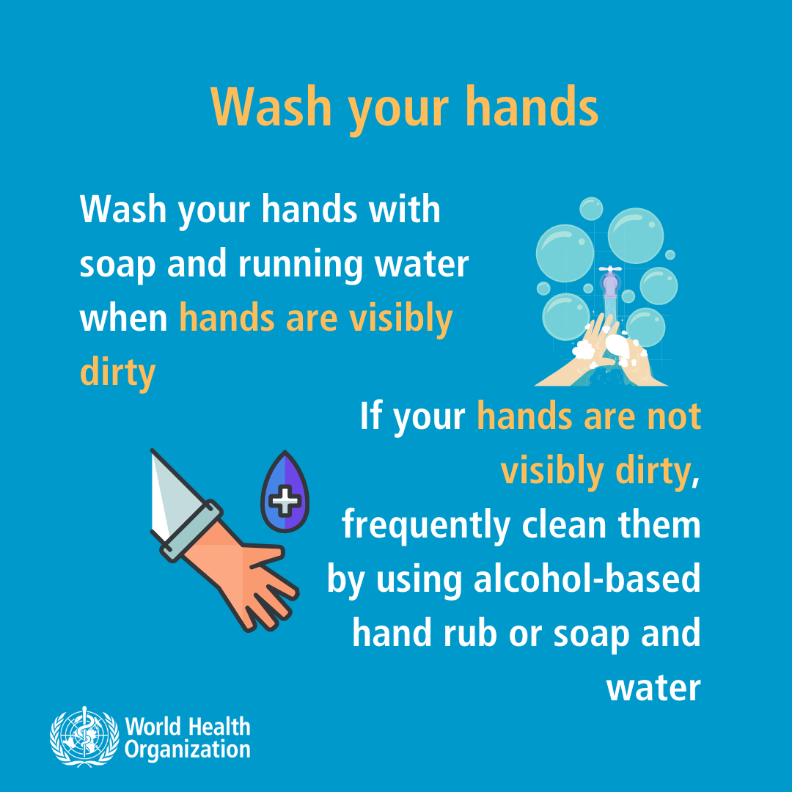
Stay healthy with handwashing!
Visit www.who.int for more information.

Slide 5
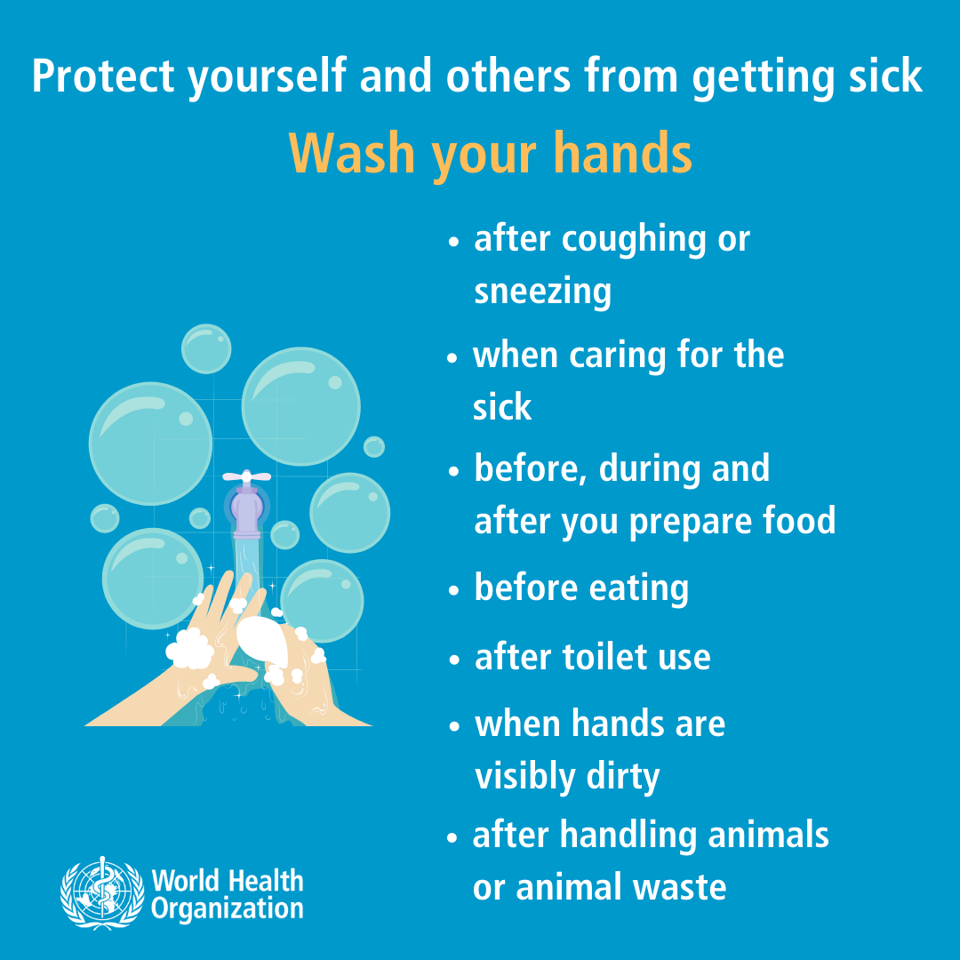
Stay healthy with handwashing!
Visit www.who.int for more information.

Slide 6
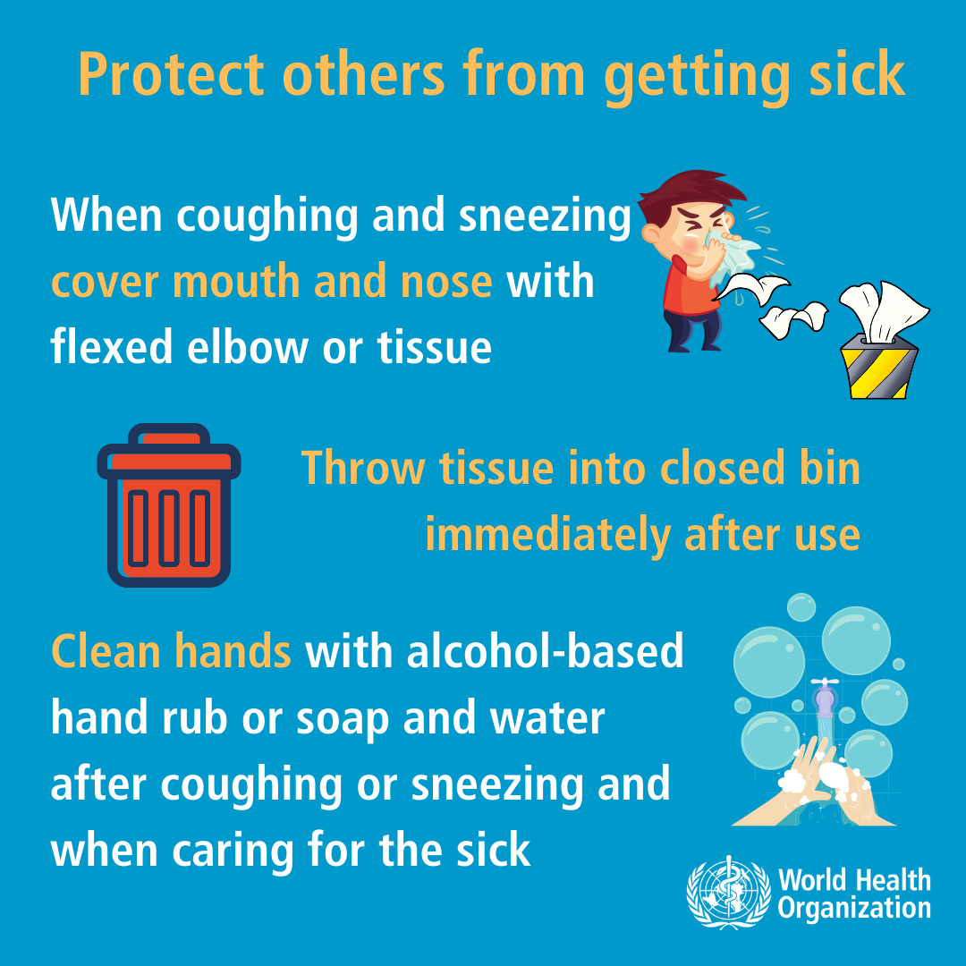
Help prevent the spread of infection!
Visit www.who.int for more information.

Slide 7
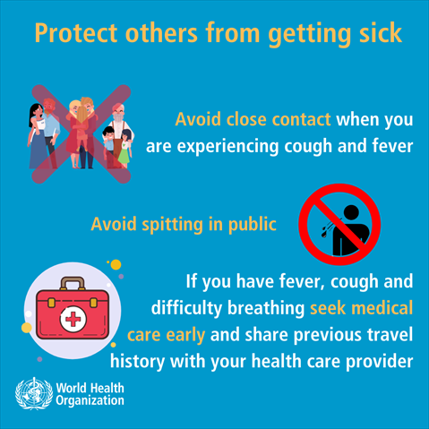
Help prevent the spread of infection!
Visit www.who.int for more information.

